Slide 1

STEPS TO DIGGING DEEPER
INTO DISCIPLESHIP!
Notes:
Good morning…I share with you a little bit of my journey in discipleship. My prayer is some things I share with you will help you too.
To help you better understand some of my struggles, let me tell you about a recent conversation I had with Pastor J Falwell.
When I met with P. J. Falwell, the first thing I said to him was this: Pastor J. I don’t know if you feel this way, but I have found in difficult to live my life in the shadow of a great man of God!
Now the moment...
Next slide

Slide 2
STEPS TO DIGGING DEEPER
INTO DISCIPLESHIP!
Notes:
After I said that, I noticed his facial expression. That told me everything I needed to know...that it wasn’t easy for him either.
Then I said to him, “It has also been difficult also because just like the great men of the bible who had flaws, my dad had his share of flaws as well.
And unfortunately, I picked up some of them as well.
The even more sad thing really for me is that I didn’t even realize that I had some of these flaws myself until about 12 years ago when I had a moment of greater clarity about my life.
King David understood this problem…that we can hide things from ourselves. He said in Ps. 139:23-24 ESV)

Slide 3
Search me, O God, and know my heart! Try me and know my thoughts! 24 And see if there be any grievous way in me,
and lead me in the way everlasting!
(Ps. 139:23-24 ESV)
Notes:
King David understood this…that we can hide things from ourselves. He said in Ps. 139:23-24 ESV)
What I would like to do this morning is share with you what the bible teaches about discipleship.
But I want you to understand something that is very important. You and I can think we have a good understanding as to how the bible teaches us to follow Christ, but we can miss something that’s really important if we don’t also better understand also “what a certain kind of disciple should look like.”
Let's begin with a word of prayer.

Slide 4

Notes:
I've been told to write a good book you have to begin with the End in Mind. That is good advice.
That is also good advice when it comes to how we live our life.
when we get...
(Next slide)

Slide 5
Digging Deeper into Discipleship
When we get to the end of our life, what is it we want to be able to see that we accomplished?
Notes:
when we get to the end of our life...?
Probably we want to do everything we can to make sure our children and grand children know the Lord.
But apart from our families' salvation, what do you want to look back and see yourself as accomplishing that has eternal value?
Now this is an important questions to ask and answer for at least one reason.
Have you heard the expression, if you aim for nothing, you will hit it every time?
So it's important that we aim higher! (Next Slide)

Slide 6

“To Succeed in Your Spiritual
Life, Aim Higher”
Notes:
To succeed in your spiritual life,...
The Apostle Paul says in Col. 3:1
(next slide)

Slide 7
Our Focus In Christ
If then you have been raised with Christ, seek the things that are above, where Christ is, seated at the right hand of God. (Col. 3:1 ESV)
14 I press on toward the goal for the prize of the upward call of God in Christ Jesus. (Phil. 3;14 ESV)
Notes:
Col. 3:1
He also said in Phil. 3:14
Slide Transition:
Phil. 3:14
What are those higher things we should seek for?
(Next Slide)

Slide 8
Question:
What was God’s plan for you and I from the beginning?
Notes:
LOVE is the greatest good.
LOVE requires free choice.
FREE CHOICE implies the possibility
of the opposite choice.
GOD alone is love, the greatest good.
GREATEST good for humanity is God’s love.
GREATEST evil for humanity is rejecting God.
TO STOP evil is to stop free choices.
TO STOP free choices is to stop love.
TO STOP love is to stop the greatest good.
TO STOP the greatest good is the greatest evil.
Question:
Do you really want God to stop your evil?
This is important answer because once we understand what that was, we may have a better idea of how we can make the most of the time the Lord has given us in this life.
(Transition thought)
But before we see how the bible answers this question, I think it would be helpful to better understand what God's plan for you and I was not.
Next Slide

Slide 9
NGIM
1. God’s Plan from the Beginning was not…
…to maximize our own personal happiness in this life.
Notes:
LOVE is the greatest good.
LOVE requires free choice.
FREE CHOICE implies the possibility
of the opposite choice.
GOD alone is love, the greatest good.
GREATEST good for humanity is God’s love.
GREATEST evil for humanity is rejecting God.
TO STOP evil is to stop free choices.
TO STOP free choices is to stop love.
TO STOP love is to stop the greatest good.
TO STOP the greatest good is the greatest evil.
Question:
Do you really want God to stop your evil?
We see in scripture that sometimes God's plan is to use suffering and trials is a part of His santification process.
James 1:2-4 says
(Next Slide)

Slide 10
Pain and Suffering Is
a part of God’s Plan For Us
3 Not only that, but we rejoice in our sufferings, knowing that suffering produces endurance, 4 and endurance produces character, and character produces hope, 5 and hope does not put us to shame, because God’s love has been poured into our hearts through the Holy Spirit who has been given to us. (Rom. 5:3-5)
Notes:
Let's first talk about what was God's general plan?

Slide 11
2. God’s Plan from the Beginning was…
His General Plan:
…to bring about the knowledge of God in this life that brings happiness in the next life.
Notes:
LOVE is the greatest good.
LOVE requires free choice.
FREE CHOICE implies the possibility
of the opposite choice.
GOD alone is love, the greatest good.
GREATEST good for humanity is God’s love.
GREATEST evil for humanity is rejecting God.
TO STOP evil is to stop free choices.
TO STOP free choices is to stop love.
TO STOP love is to stop the greatest good.
TO STOP the greatest good is the greatest evil.
Question:
Do you really want God to stop your evil?
Rev. 21:4 says

Slide 12
God’s Final Plan
4 ”He will wipe away every tear from their eyes, and death shall be no more, neither shall there be mourning, nor crying, nor pain anymore, for the former things have passed away.” (Rev. 21:4 ESV)
Notes:
Let me say this in another way

Slide 13
2. God’s Plan from the Beginning was…
His General Plan:
…to maximize the potential for good and quarantine evil forever (Matt. 13:36-43).
Notes:
LOVE is the greatest good.
LOVE requires free choice.
FREE CHOICE implies the possibility
of the opposite choice.
GOD alone is love, the greatest good.
GREATEST good for humanity is God’s love.
GREATEST evil for humanity is rejecting God.
TO STOP evil is to stop free choices.
TO STOP free choices is to stop love.
TO STOP love is to stop the greatest good.
TO STOP the greatest good is the greatest evil.
Question:
Do you really want God to stop your evil?
We see this clearly in a parable Jesus shares in Matt. 13:24-43

Slide 14
To Maximize The Potential…
24 He put another parable before them, saying, “The kingdom of heaven may be compared to a man who sowed good seed in his field, 25 but while his men were sleeping, his enemy came and sowed weeds among the wheat and went away. 26 So when the plants came up and bore grain, then the weeds appeared also. 27 And the servants of the master of the house came and said to him, ‘Master, did you not sow good seed in your field? How then does it have weeds?’ 28 He said to them, ‘An enemy has done this.’ So the servants said to him, ‘Then do you want us to go and gather them?’ 29 But he said, ‘No, lest in gathering the weeds you root up the wheat along with them (Matt. 13:24-29 ESV).
Notes:
The exhortation was to not cut down the weeds. )28-29
Why? - because one could accidentially remove the potential for more growth of the wheat.
Now if we had any doubt about what Jesus was saying here in this parable, we only need to go a few verses further in 36-43 to see Jesus's explanation of this parable to his disciples.

Slide 15
To Maximize The Potential…
³⁶ Then he left the crowds and went into the house. And his disciples came to him, saying, “Explain to us the parable of the weeds of the field.”³⁷ He answered, “The one who sows the good seed is the Son of Man.³⁸ The field is the world, and the good seed is the sons of the kingdom. The weeds are the sons of the evil one,³⁹ and the enemy who sowed them is the devil. The harvest is the end of the age, and the reapers are angels.⁴⁰ Just as the weeds are gathered and burned with fire, so will it be at the end of the age.⁴¹ The Son of Man will send his angels, and they will gather out of his kingdom all causes of sin and all law-breakers,⁴² and throw them into the fiery furnace. In that place there will be weeping and gnashing of teeth.⁴³ Then the righteous will shine like the sun in the kingdom of their Father. He who has ears, let him hear. (Matt. 13:36-43 ESV)
Notes:
Look at what Norm Geisler says about God's plan.

Slide 16
His General Plan:
“…He is the best of all beings possible and, as such, He must produce the best of all worlds actually possible (if He is going to create). Permitting this evil world is the best of all possible ways to produce the best of all possible worlds.”
Norm Geisler, If God, Why Evil? P. 68-69
Notes:
"He is the best of all...
Rev. 21:4 says some day there will be no sorry or pain
If that was His general plan,
What then was God's specific plan...
Next Slide

Slide 17
Question:
What was God’s Specific Plan For Mankind Since The Beginning?
What was God’s concern with Adam and Eve, even before the Fall?
Why did God allow Lucifer to tempt Eve?
Why did God permit the possibility of evil?
Why should God allow evil in His sovereign plan?
Notes:
LOVE is the greatest good.
LOVE requires free choice.
FREE CHOICE implies the possibility
of the opposite choice.
GOD alone is love, the greatest good.
GREATEST good for humanity is God’s love.
GREATEST evil for humanity is rejecting God.
TO STOP evil is to stop free choices.
TO STOP free choices is to stop love.
TO STOP love is to stop the greatest good.
TO STOP the greatest good is the greatest evil.
Question:
Do you really want God to stop your evil?
To help you answer this question I want you to think about and answer these other 4 questions?
(Slide Transition)
What was God's concern with Adam and Eve even before the Fall?
Why did God allow Lucifer to tempt Eve?
Why did God permit the possibility of evil?
Why should God allow evil in His Sovereign plan?
Here is one other question we should consider:
(Next Slide)

Slide 18
By God allowing the possibility of evil to enter this world, and yet knowing God’s attributes, what does that tell you about what God was doing and why?
One Other Question To Consider…
Notes:
One other question to consider
I think answering all of these questions will lead to one inescapable conclusion:

Slide 19
3. God’s specific plan from the beginning was the redemption of mankind!
How do we know this is true?
Redemption was part of God predetermined plan! (1 Pet. 1:18-20).
Notes:
LOVE is the greatest good.
LOVE requires free choice.
FREE CHOICE implies the possibility
of the opposite choice.
GOD alone is love, the greatest good.
GREATEST good for humanity is God’s love.
GREATEST evil for humanity is rejecting God.
TO STOP evil is to stop free choices.
TO STOP free choices is to stop love.
TO STOP love is to stop the greatest good.
TO STOP the greatest good is the greatest evil.
Question:
Do you really want God to stop your evil?
Slide transition:
How do we know...
(Slide Transition)
Redemption...
(Next slide)

Slide 20
God’s Original Plan Was Redemption
Knowing that you were ransomed from the futile ways inherited from your forefathers, not with perishable things such as silver or gold, but with the precious blood of Christ, like that of a lamb without blemish or spot. He was foreknown before the foundation of the world but was made manifest in the last times for the sake of you (1 Pet. 1:18-20 ESV).
Notes:
Peter say, "Knowing that you...
It was God's predetermined plan that Christ would die.
Yes Jesus said in John 10:17-18 I lay down my life freely.
Eph. 2:13-16 the Apostle Paul says....
(Next slide)

Slide 21
Redemption of Mankind
13 But now in Christ Jesus you who once were far off have been brought near by the blood of Christ. 14 For he himself is our peace, who has made us both one and has broken down in his flesh the dividing wall of hostility15 by abolishing the law of commandments expressed in ordinances, that he might create in himself one new man in place of the two, so making peace,16 and might reconcile us both to God in one body through the cross, thereby killing the hostility. (Eph. 2:13-16 ESV)
Notes:
Listen to what W. Graham Scroggie says about God's Plan

Slide 22
3. God’s specific plan from the beginning…
?
“The underlying theme of all the Scriptures is Redemption: in the Old Testament the anticipation of it in type and prophecy; in the Gospels the accomplishment of it by the death of Christ; In the Acts and Epistles, the application of it to the needs of man; in the Revelation, the achievement of it in the subjection of all kingdoms to the rule of God.”
W. Graham Scroggie, The Unfolding Drama of Redemption, p. 32
Notes:
Here is a key statement we need to better understand that the bible teaches that is foundational in our understanding about discipleship:
Now if "Redemption..
(Next Slide)

Slide 23
The church’s passion…?
If redemption of mankind was God’s greatest plan, fulfilling the Great Commission should be the church’s greatest passion!
Notes:
LOVE is the greatest good.
LOVE requires free choice.
FREE CHOICE implies the possibility
of the opposite choice.
GOD alone is love, the greatest good.
GREATEST good for humanity is God’s love.
GREATEST evil for humanity is rejecting God.
TO STOP evil is to stop free choices.
TO STOP free choices is to stop love.
TO STOP love is to stop the greatest good.
TO STOP the greatest good is the greatest evil.
Question:
Do you really want God to stop your evil?
Do you believe that?
I'll be honest...
So much of my life the Great Commission was either accidental or at best on a times supplimental in my life. But I never even attempted to make it more fundamental in my life until 8 years ago.

Slide 24
I. The Great Commission (Horizonal Focus)
Principles to Remember:
People matter to God and that should matter to us!
2. Jesus didn’t teach us to just go and make converts only!
Notes:
Remember that Jesus...
1. People matter to God and that should...
(Slide Transtion)
2. Jesus didn't teach us to...
Jesus believed that only through multiplication, not addition, can we even attempt to fulfill the great commission.
Jesus said,...
(Next Slide)
Go therefore...

Slide 25
Go therefore and make disciples of all nations, baptizing them in the name of the Father and of the Son and of the Holy Spirit,20 teaching them to observe all that I have commanded you. And behold, I am with you always, to the end of the age.”
(Matt. 28:19-20 ESV)
Notes:
God Cares About The Whole World! That is why Jesus' last words were go and make Disciples.
Why? Because Jesus knew that making converts only wouldn't get the job done.
Listen to what my friend, Rev. Edmund Chan says about this focus on spiritual multiplication:

Slide 26
“Spiritual multiplication through disciplemaking is God’s plan in the New Testament for evangelizing the lost and for multiplying the saints.”
Edmund Chan, A Certain Kind, p. 100-101.
QUESTION:
What would you rather have? One penny that doubles each day for 31 days or $100,000 each day for 31 days?
Answer: With the penny you make 3 times more!
$10,737, 418.24 not $3,100,000
Notes:
I wished I understood this idea in a greater way when I lived in Singapore.
Let me ask you this question:
(Slide transition)
What would you rather have...
Slide Transition:
Answer: With the penny you make...
Slide transition
$3,100,000 or 10,737, 418.24
Can I suggest we also need to be more intentional about how we go about making disciples.
Now I want to put together another important piece in the discipleship process.

Slide 27

Putting The Pieces Together…
Why is the great commandment also so important?
Notes:
I want to help you understand how to put together...the two pieces: the Great Commission and the Great Commandment.
Slide Transition:
Why is the great commandment...
Listen to what my friend Rev. Edmund Chan says about the principle of spiritual multiplication through discipleship.
(Next Slide)

Slide 28
“The Great Commission is the core mission of the Church, not her chief mandate.”
“The assignment of the Great Commission cannot be meaningfully carried out without an alignment to the Great Commandment.”
Edmund Chan, A Certain Kind, p. 115
Notes:
He continues his thought....
"Only when...

Slide 29
“Only when we are aligned to God in love do we have access to God’s resources and God’s power, through God’s Spirit, to fulfil God’s purpose for God’s glory.”
Edmund Chan, A Certain Kind, p. 115
Notes:
So let's talk for a few minutes about the Great Commandment.

Slide 30
II. The Great Commandment
(Vertical and Horizontal Focus)
Notes:
Let's talk about both it's vertical focus and it's horizontal focus
What is the Great Commandment?
We see this in Deut. 6:5
"You shall love the Lord your God with all your heart and with all your soul and with all your might. " Deut. 6:5
Jesus also talks about it in Matt. 22:37-40 "You shall
(Next Slide)

Slide 31
The Great Commandment
37 And he said to him, “You shall love the Lord your God with all your heart and with all your soul and with all your mind. 38 This is the great and first commandment. 39 And a second is like it: You shall love your neighbor as yourself. 40 On these two commandments depend all the Law and the Prophets.” (Matt. 22:37-40 ESV)
Notes:
Remember I said at the beginning of my teaching that "We should begin with the end in mind?
Jesus is doing the same thing with his listeners saying all that you were taught to do in the Old Testament can be summarized by saying: Love God and Love your neighbor.
This is exactly what God calls each of us to do!
To love God and Love others.
Listen to another important insight from Edmund Chan

Slide 32
“The Great Commandment makes sense only to those who completely believe in the divine paradox; that whoever tries to save his life will lose it, but whoever loses it for God’s sake will find it (Matt. 10:39).”
”Loving God redefines everything. It defines for us the kind of persons we are to be, the promises on which we are to live, and the purposes to which we are to commit our lives.”
Edmund Chan, A Certain Kind, p. 100
Notes:
Slide transition:
Loving God redefines...
Here's another helpful insight from Edmund Chan

Slide 33
“All our work for God counts for nothing if we do not love Him. Everything must begin with loving God; and one cannot love God without loving others. Loving others ultimately expresses itself in our desire to see them believe in Christ and grow in Christlikeness towards maturity Thus a disciplemaking Church fulfils the Great Commandment by being true to the Great Commission. True discipleship teaches us to love.”
Edmund Chan, A Certain Kind, p. 88.
Notes:
Are you getting the bigger picture. Do you see now how the pieces of the Great Commission and the Great Commandment come together?
So here are some things you and I should remember about discipleship:

Slide 34
1. The first part of our commitment to discipleship may come about when we desire more and more to be like Christ.
Our Commitment To Discipleship
Things To Remember about Discipleship
Notes:
Things to remember...
(Slide Transition)
1. The first part of our commitment...
When we desire to make Christ first in our life everything else in our life will pale by comparison!
Jesus says
(Next Slide)

Slide 35
The Cost of Discipleship
23 And he said to all, “If anyone would come after me, let him deny himself and take up his cross daily and follow me. 24 For whoever would save his life will lose it, but whoever loses his life for my sake will save it. 25 For what does it profit a man if he gains the whole world and loses or forfeits himself?” (Luke 9:23-25 ESV)
Notes:
2. The second part of our....
(Next Slide)

Slide 36
2. The second part of our commitment to discipleship may come about when we see the benefit of following Him and want to encourage others to follow Him also. (john 4:)
Our Commitment To Discipleship
Things To Remember about Discipleship
Notes:
The second part of our commitment to...
Do you remember what the Apostle John said about the women at the well after her encounter with Christ?
(Next slide)

Slide 37
28 So the woman left her water jar and went away into town and said to the people,29 “Come, see a man who told me all that I ever did. Can
this be the Christ?”30 They went out of
the town and were coming to him.
(John 4:28-30 ESV)
Notes:
Let me make an important observation:
If you and I care about following Jesus we should all care deeply that others follow Jesus also.
I'd like to make one other important point about discipleship that I mentioned at the beginning.

Slide 38
Our impact on others can be minimal if we aren’t a certain kind of Disciple of Christ!

Slide 39

What is a Certain Kind of Discipleship...?
One that understands
that that mandate should
precede the mission.
Notes:
Can I suggest it is "one understand that ....
(Slide transition)
Let me Illustration this point from my own life:
about 8 years ago...North Carolina
Reading Matt. 5
I asked myself a question:
Why doesn't it say in Matt. 5 "Blessed are those who make disciples.
then I remembered what my friend had been trying to teach me... that the mandate should precede the mission.
Listen to how Edmund Chan distinguishes these things.
(Next Slide)

Slide 40
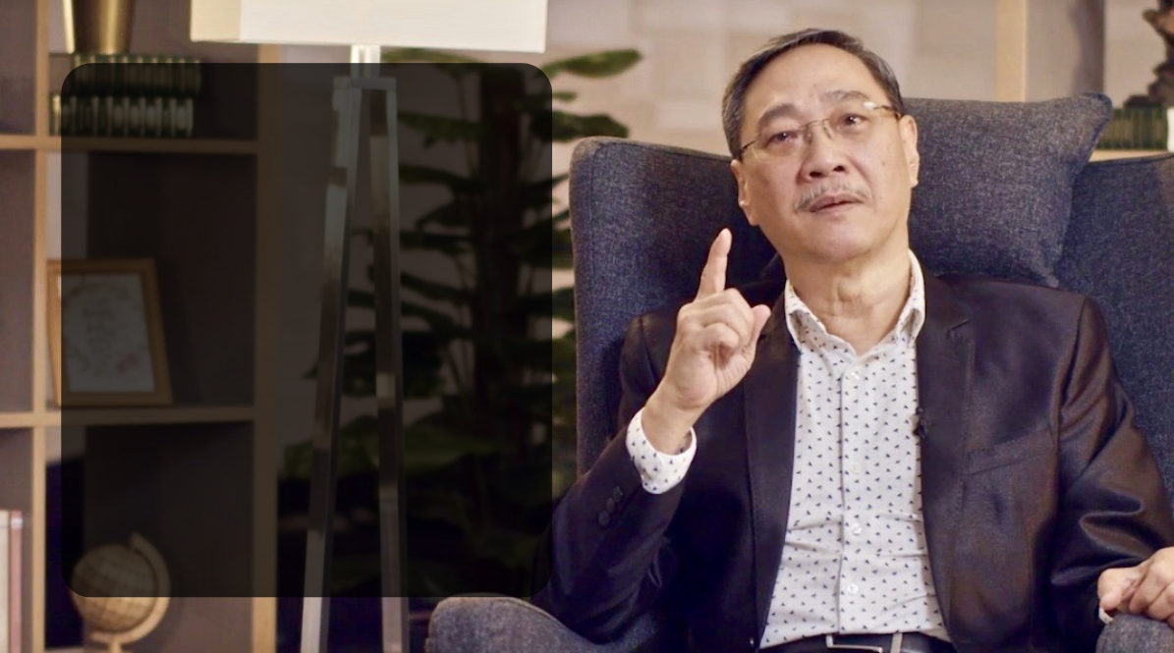
"The mandate focuses on our walk in God, and the mission focuses on our work for God. The mandate focuses on character, whereas the mission focuses on accomplishments. The mandate focuses on being, the mission focuses on doing."
- Pastor Edmund Chan
A Certain Kind, p. 113
Notes:
Here is an insight we need to better understand.
"The enemy's...
(Next Slide)

Slide 41
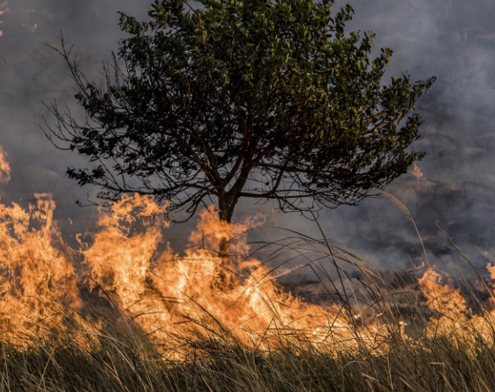
The enemy's strategy is to get you and I to focus on the mission and neglect the mandate!
Notes:
The enemy's strategy is... (VERY IMPORTANT POINT)
that day on the coast of North Carolina I realized that I had spent most of my life focusing on the mission and yet had neglected the mandate in my life.
I also realized something else. I had neglected my most important mission my family.
And from that time I learned to say something that my dad had trouble saying to me when I was a boy.
Do you know what that is?
"I am sorry will you forgive me."
I also realized something else that day.

Slide 42
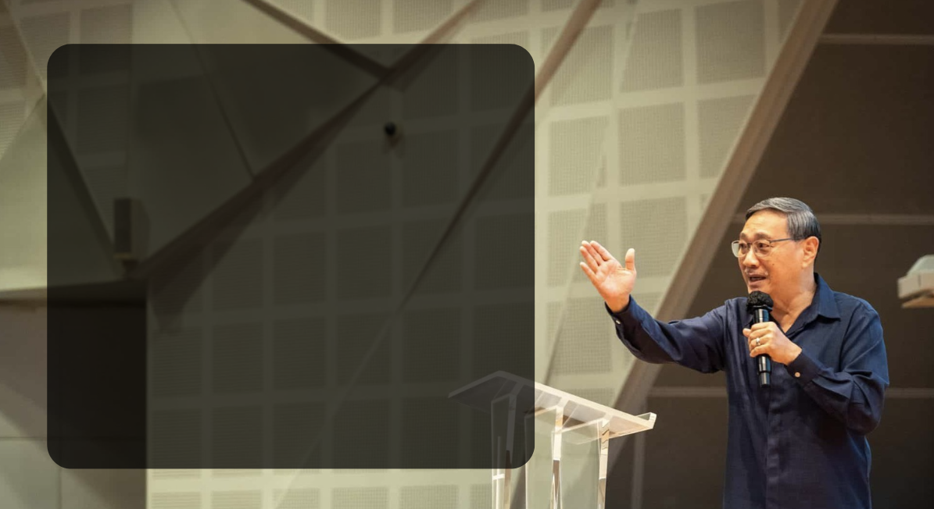
”…the key to abiding in Christ (our MASTER) is..."
"...Acknowledging and mourning our spiritual poverty!"
Rev. Edmund Chan
Notes:
The key to abiding..."
Only when we acknowledge to God we have nothing...can He begin to work the transformation in our lives He wants us to work.
(Next Slide)

Slide 43

Matthew 5:3-4 (ESV)
"Blessed are the poor in spirit, for theirs is the kingdom of heaven, blessed are those who mourn..."
Notes:
Here is my observation about this passage:
(Next Slide)

Slide 44
"It is not just an awareness of our spiritual poverty that is important to God. It is also our deep anguish about it that is important to God and should be important to us."
Dr. David Geisler
Notes:
Here is the conclusion I came to:
"It's not just an awareness of our...
(IMPORTANT POINT)
One of the other things that I started realizing more and more eight years ago is how if you don't deal with the baggage of your past, you may carry that with you into the present.
NOW I REALIZE THAT The bible teaches in Phil. 3:13-14 and important principle about "pressing on towards the goal...
(Next Slide)

Slide 45
³ Brothers, I do not consider that I have made it my own. But one thing I do: forgetting what lies behind and straining forward to what lies ahead, ¹⁴ I press on toward the goal for the prize of the upward call of God in Christ Jesus.
(Phil. 3:13-14)
Notes:
However we need to remember this truth also,

Slide 46
If we allow the baggage of our past to still clink to us in the present, it may also keep us from being that certain kind of disciple God wants us to be.
Notes:
LOVE is the greatest good.
LOVE requires free choice.
FREE CHOICE implies the possibility
of the opposite choice.
GOD alone is love, the greatest good.
GREATEST good for humanity is God’s love.
GREATEST evil for humanity is rejecting God.
TO STOP evil is to stop free choices.
TO STOP free choices is to stop love.
TO STOP love is to stop the greatest good.
TO STOP the greatest good is the greatest evil.
Question:
Do you really want God to stop your evil?
If we allow the baggage of our past .....
Sometimes we can be blind to the baggage we are clinging on to and it can cause real damage.
That is why King David prayed In Ps. 139:23-24 ESV)

Slide 47
Search me, O God, and know my heart! Try me and know my thoughts! 24 And see if there be any grievous way in me,
and lead me in the way everlasting!
(Ps. 139:23-24 ESV)
Notes:
"Search me O God and no my heart...
Let me just challenge all of you to consider what are the next steps God wants you to take in your obedience to him
and also what are those things, you need to deal with and then lay aside, so you too can win the prize!
Hebrews 12:1-2
12 Therefore, since we are surrounded by so great a cloud of witnesses, let us also lay aside every weight, and sin which clings so closely, and let us run with endurance the race that is set before us,

Slide 48
Summary
What was God’s plan in redeeming us?
  So we can be reconciled to God.
What was His eternal plan for mankind for those who accept His gift to be redeemed?
  Intimate eternal fellowship with God and conforming us to be just like Christ (1 Jn. 3:2).
Notes:
What was God's plan...
(Slide Transition)
- So we can be reconciled..
(Slide Transition)
What was His eternal plan for mankind...
(Slide Transition)
Intimate eternal fellowship...
So here's my summary statement about God's plan since the beginning:

Slide 49
  “God's eternal plan was paradise lost and restored through the redemption of Christ which will result in eternal intimate fellowship with God and total Christ likeness for His followers.
  But God’s plan is also that we, as followers of Christ, need to lovingly, and by the power of the Holy Spirit, multiply ourselves into the lives of others so that they can experience what we have experienced.”
  - Dr. David Geisler
Notes:
(Slide transition)
But God's plan is also

Slide 50
Digging Deeper into Discipleship
When we get to the end of our life, what should have been our larger goal all through our life?
Answer:
Our focus vertically and our focus horizontally (Our relationship with God and our relationship with Others).
Notes:
Answer: (Slide Transition)

Slide 51
Our Vertical Focus
1. Our Vertical focus should be three:
Loving God (The Great Commandment)
Knowing God better and developing greater intimacy with Him.
Becoming more like Christ.

Slide 52
Our Horizontal Focus
2. Our Horizontal focus should be two:
Loving our Neighbor (The Great Commandment)
The Great Commission

Slide 53
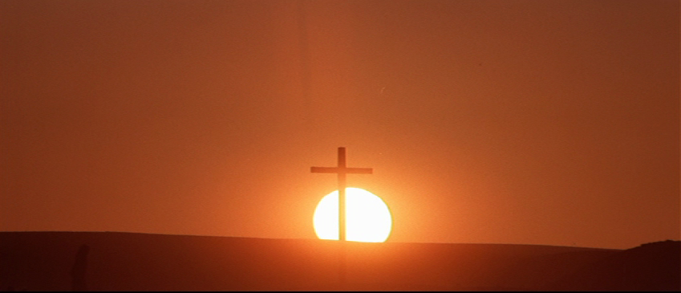

What changes will you make if you purpose to live your life by the Word of God?

Slide 54
STEPS TO DIGGING DEEPER
INTO DISCIPLESHIP!

